Slide 1
Lecture 8: Functional Programming in Java 8 Commanding All the Laws of Nature from the Source

Slide 2
Wholeness Statement
The declarative style of functional programming makes it possible to write methods (and programs) just by declaring what is needed, without specifying the details of how to achieve the goal. Including support for functional programming in Java makes it possible to write parts of Java programs more concisely, in a more readable way, in a more threadsafe way, in a more parallelizable way, and in a more maintainable way, than ever before.
Maharishi’s Science of Consciousness: Just as a king can simply declare what he wants – a banquet, a conference, a meeting of all ministers – without having to specify the details about how to organize such events, so likewise can one who is awake to the home of all the laws of nature, the “king” among laws of nature, command those laws and thereby fulfill any intention. The royal road to success in life is to bring awareness to the home of all the laws of nature, through the process of transcending, and live life established in this field.

Slide 3

Features of Functional Programming
Programs are declarative (“what”) rather than imperative (“how”). Makes code more self-documenting – the sequence of function calls mirrors precisely the requirements
Functions have referential transparency ­– two calls to the same method are guaranteed to return the same result
lacks referential transparency; produces a side effect
Notes:
1.
Imperative Programming means any style of programming where your program is structured out of instructions describing how the operations performed by a computer will happen.
Declarative Programming means any style of programming where your program is a description either of the problem or the solution - but doesn't explicitly state how the work will be done.
Functional Programming is programming by evaluating functions and functions of functions... As (strictly defined) functional programming means programming by defining side-effect free mathematical functions so it is a form of declarative programming but it isn't the only kind of declarative programming.
Logic Programming (for example in Prolog) is another form of declarative programming. It involves computing by deciding whether a logical statement is true (or whether it can be satisfied). The program is typically a series of facts and rules - i.e. a description rather than a series of instructions.
Term Rewriting (for example CASL) is another form of declarative programming. It involves symbolic transformation of algebraic terms. It's completely distinct from logic programming and functional programming.
2.
http://poincare101.blogspot.com/2012/02/whats-referential-transparency.html
3.

Slide 4
Features of Functional Programming
Functions do not cause a change of state; in an OO language, this means that functions do not change the state of their enclosing object (by modifying instance variables). In general, functions do not have side effects; they compute what they are asked to compute and return a value, without modifying their environment (modifying the environment is a side effect). [See example, previous slide]
Functions are first-class citizens. This means in particular that it is possible to use functions in the same way objects are used in an OO language: They can be passed as arguments to other functions and can be the return value of a function.

Slide 5
The Functional Style of Programming (cont.)
Demos show examples of adopting a Functional Programming style within Java SE 7. See lesson8.lecture.functionalprogramming.
These are not true functional programming examples because they rely on simpler methods that are not purely functional. But these examples illustrate the functional style at the top level. In Java SE 8, these techniques are supported in a truly functional (and much more efficient) way.

Slide 6
Benefits of the Functional Style
Programs are more compact, easier to write, and easier to read/understand
Programs are thread-safe
Easier to demonstrate correctness of functional programs
Easier to test; less likely that a test of a subroutine will fail tomorrow if it passed today since there are no side effects

Slide 7
Functional Programming in Java
Java designers – in agreement with many experts – decided it was time to incorporate the many benefits of the functional style of programming into Java
Java will remain an OO language, with all the benefits of OO for building and maintaining large-scale applications
For specialized needs – for instance, to extract data from a large collection using SQL-like queries – a functional approach would be more efficient, easier to read, and less error-prone
Another potential benefit: Significant increase in performance because of automatic support for parallelizing code.

Slide 8
How Java SE 7 Approximates “Functions As First-Class Citizens”
Problem: Sort a list of Employee objects.
class Employee { String name; int salary; public Employee(String n, int s) { this.name = n; this.salary = s; } }
To sort, we need a criterion for comparing two Employee objects. We can define a function compare that tells us how to do this:
int compare(Employee e1, Employee e2) { return e1.name.compareTo(e2.name); }

Slide 9
How Java SE 7 Approximates “Functions As First-Class Citizens”
Problem: Sort a list of Employee objects.
class Employee { String name; int salary; public Employee(String n, int s) { this.name = n; this.salary = s; } }
To sort, we need a criterion for comparing two Employee objects. We can define a function compare that tells us how to do this:
int compare(Employee e1, Employee e2) { return e1.name.compareTo(e2.name); }
Natural thing to try to do:
Collections.sort(list, compare)

Slide 10
How Java SE 7 Approximates “Functions As First-Class Citizens”
Problem: Sort a list of Employee objects.
class Employee { String name; int salary; public Employee(String n, int s) { this.name = n; this.salary = s; } }
To sort, we need a criterion for comparing two Employee objects. We can define a function compare that tells us how to do this:
int compare(Employee e1, Employee e2) { return e1.name.compareTo(e2.name); }
Natural thing to try to do:
Collections.sort(list, compare) BUT, functions are not first-class citizens in Java, so this cannot be done.

Slide 11
How Java SE 7 Approximates “Functions As First-Class Citizens”
The Comparator interface is a declarative wrapper for the function compare.
interface Comparator<T> { int compare(T o1, T o2);
}

Slide 12
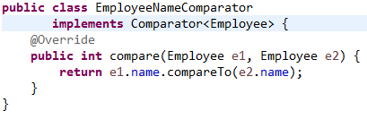
How Java SE 7 Approximates “Functions As First-Class Citizens”
The Comparator interface is a declarative wrapper for the function compare.
interface Comparator<T> { int compare(T o1, T o2);
}
Although we cannot pass the function compare as an argument to the sort method, we can pass an instance of Comparator.

Slide 13
How Java SE 7 Approximates “Functions As First-Class Citizens”
The Comparator interface is a declarative wrapper for the function compare.
interface Comparator<T> { int compare(T o1, T o2);
}
Although we cannot pass the function compare as an argument to the sort method, we can pass an instance of Comparator.
Now we can pass in the Comparator to sort a list of Employees:
Collections.sort(list, new EmployeeNameComparator())

Slide 14
Functional Interfaces
A Comparator is called a functional interface because it has just one (abstract) method. A class that implements it will have just one implemented function; it will be an object that acts like a function.
NOTE: Though EmployeeNameComparator is a class, it is essentially just a function that associates to each pair (e1,e2) of Employees an integer (indicating an ordering for (e1, e2)).

Slide 15
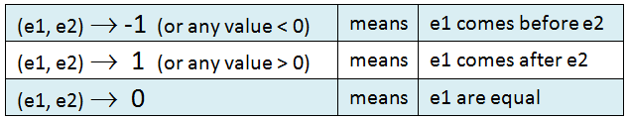
Functional Interfaces
A Comparator is called a functional interface because it has just one (abstract) method. A class that implements it will have just one implemented function; it will be an object that acts like a function.
NOTE: Though EmployeeNameComparator is a class, it is essentially just a function that associates to each pair (e1,e2) of Employees an integer (indicating an ordering for (e1, e2)).

Slide 16
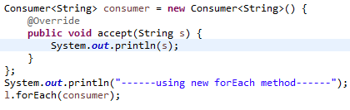
Another Functional Interface: Consumer
public interface Consumer<T> { public void accept(T t); }
The Consumer interface, like Comparator, has just one abstract method, so it is also a functional interface.

Slide 17
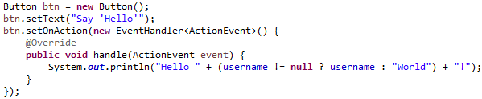
Another Functional Interface: EventHandler<T>
public interface EventHandler<T extends Event> { public void handle(T evt);//typically, T is ActionEvent }
One of the primary event handlers in JavaFX is EventHandler, another functional interface. From Lesson 6, we have:

Slide 18
Functor and Closure
An implementation of a functional interface is called a functor. Example:
public class EmployeeNameComparator implements Comparator<Employee> {
@Override
public int compare(Employee e1, Employee e2) {
return e1.name.compareTo(e2.name);
}
}
A closure is a functor embedded inside another class, that is capable of remembering the state of its enclosing object. In Java 7, instances of member, local, and anonymous inner classes are (essentially) closures, since they have full access to their enclosing object’s state.

Slide 19
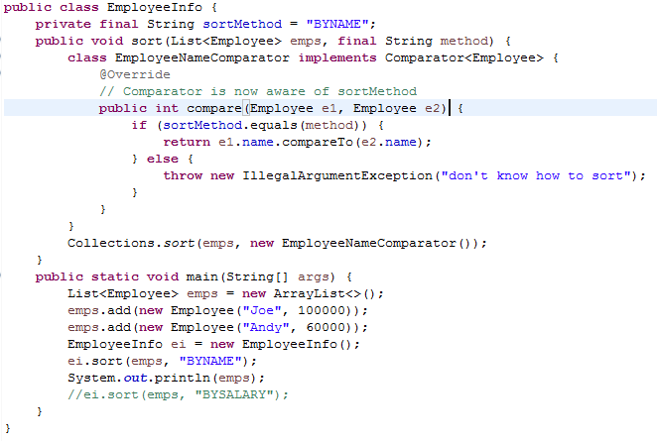
An example of Closure

Slide 20
Closure and Lambda Expressions
Lambda Expressions are syntax shortcuts for closures.
Lambdas upgrade the status of functions (at least in a certain context) to first-class citizens.

Slide 21
Introducing Lambda Expressions
Lambda notation was an invention of the mathematician A. Church in his analysis of the concept of “computable function,” long before computers had come into existence (in the 1930s). Several equivalent ways of specifying a (mathematical) function:
f(x, y) = 2x – y //this version gives the function a name – namely ‘f ’
(x,y) ↦ 2x – y //in mathematics, this is called “maps to” notation λxy.2x – y //Church’s lambda notation
(x,y) -> 2*x – y // Java SE 8 lambda notation
NOTE: In Church’s lambda notation, the function’s arguments are specified to the left of the dot, and output value to the right.

Slide 22
Anatomy of a Lambda Expression
A lambda expression has three parts:
parameters [zero or more] -> code block [if more than one statement, enclosed in curly braces { . . . } ]
[may contain free variables; values for these supplied
by local or instance variables]

Slide 23
Using a Lambda Expression for a Consumer
Recall the Consumer interface and the application
public interface Consumer<T> { public void accept(T t); }
This forEach code can be rewritten using lambdas as follows (syntax rules will be provided later):
l.forEach(s -> System.out.println(s));
Note how we are, in effect, simply passing the accept method of an anonymously defined Consumer to the forEach method.

Slide 24
Example: the Function (x,y) -> 2 * x – y
Java SE 8 offers new functional interfaces to support the majority of lambda expressions that could arise (though not all).
The BiFunction<S,T,R> interface has as its unique abstract method apply(), which returns the result of applying a function to it first two arguments (of type S, T) to produce a result (of type R).
public interface BiFunction<S,T,R> { R apply(S s, T t); }

Slide 25
This code uses lambda notation to express functional behavior.
public static void main(String[] args) {
BiFunction<Integer, Integer, Integer> f =
(x,y) -> 2 * x - y;
System.out.println(f.apply(2, 3)); //output: 1
}
One way to accomplish the same thing without lambdas would be like this:
public static void main(String[] args) {
class MyBiFunction implements
BiFunction<Integer, Integer, Integer> {
public Integer apply(Integer x, Integer y) {
return 2 * x - y;
}
}
MyBiFunction f = new MyBiFunction();
System.out.println(f.apply(2, 3)); // output 1
}

Slide 26
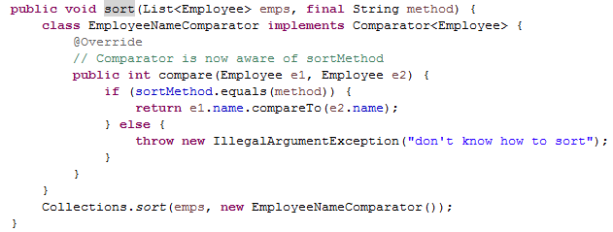
More Examples:
//compare in Comparator: two parameters e1, e2; two free variables sortMethod and method (Employee e1, Employee e2) ->
{
if (sortMethod.equals(method)) {
return e1.name.compareTo(e2.name);
} else
throw new IllegalArgumentException("don't know how to sort");
}
//handle in EventHandler: one parameter evt, one free vble username
(ActionEvent evt) -> System.out.println("Hello " + (username != null ? username : "World") + "!");

Slide 27
Free Variables
Free variables are variables that are not parameters and not defined inside the block of code (on the right hand side of the lambda expression)
In order for a lambda expression to be evaluated, values for the free variables need to be supplied (either by the method in which the lambda expression appears or in the enclosing class). These values are said to be captured by the lambda expression.

Slide 28
Creating Your Own Functional Interface: Demo: lesson8.lecture.lambdaexamples.trifunction
@FunctionalInterface
public interface TriFunction<S,T,U,R> {
R apply(S s, T t, U u);
}
public static void main(String[] args) {
TriFunction<Integer, Integer, Integer, Integer> f =
(x, y, z) -> x + y + z;
System.out.println(f.apply(2, 3, 4)); //output: 9
}
Notes:
The @FunctionalInterface annotation is checked by the compiler – if the interface does not contain exactly one abstract method, there is a compiler error.
It is not necessary to use this annotation when providing a type for a lambda expression, but, like other annotations (@Override for example) it is a best practice because it allows a compiler check that would otherwise be overlooked until runtime.

Slide 29
Exericses: What happens when we attempt to create these interfaces? Does the code compile? Are these functional interfaces?
public interface Example1 {
String toString();
}
@FunctionalInterface
public interface Example2 {
String toString();
void act();
}

Slide 30
Main Point 1
In Java, before Java SE 8, functions were not first-class citizens, which made the functional style difficult to implement. Prior to Java SE 8, Java approximated a function with a functional interface; when implemented as an inner class, objects of this type were close approximations to functions. In Java SE 8, these inner class approximations can be replaced by lambda expressions, which capture their essential functional nature: Arguments mapped to outputs. With lambda expressions, it is now possible to reap many of the benefits of the functional style while maintaining the OO essence of the Java language as a whole. The “purification” process that made it possible to transform “noisy” one-method inner classes into simple functional expressions (lambdas) is like the purification process that permits a noisy nervous system to have a chance to operate smoothly and at a higher level. This is one of the powerful benefits of the transcending process.

Slide 31
A Sample Application of Lambdas
Task: Extract from a list of names (Strings) a sublist containing those names that begin with a specified character, and transform all letters in such names to uppercase.
Imperative Style (Java 7)
public List<String> findStartsWithLetterToUpper(
List<String> list, char c) {
List<String> startsWithLetter = new ArrayList<String>();
for(String name : list) {
if(name.startsWith("" + c)) {
startsWithLetter.add(name.toUpperCase());
}
}
return startsWithLetter;
}

Slide 32
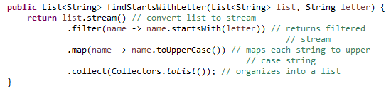
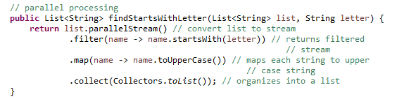
A Sample Application of Lambdas (cont.)
Using Lambdas and Streams (Java 8)

Slide 33
Naming Lambda Expressions
We want to be able to reuse lambda expressions rather than rewriting the entire expression each time. To do so, we need to give it a name and a type.
Every object in Java has a type; the same is true of lambda expressions.
The type of a lambda expression is any functional interface for which the lambda expression is an implementation!

Slide 34
Naming Lambda Expressions (cont.)
Example: Consider this lambda expression:
(Employee e1, Employee e2) -> e1.getName().compareTo(e2.getName());
What functional interface has been implemented here?

Slide 35
Naming Lambda Expressions (cont.)
Example: Consider this lambda expression:
(Employee e1, Employee e2) -> e1.getName().compareTo(e2.getName());
What functional interface has been implemented here?
Analysis. The lambda accepts two input arguments – e1 and e2 – and has a return value of type Integer. We must find (or create) a functional interface whose encapsulated function has these characteristics.

Slide 36
Naming Lambda Expressions (cont.)
Example: Consider this lambda expression:
(Employee e1, Employee e2) -> e1.getName().compareTo(e2.getName());
What functional interface has been implemented here?
Analysis. The lambda accepts two input arguments – e1 and e2 – and has a return value of type Integer. We must find (or create) a functional interface whose encapsulated function has these characteristics.
How to Search. The new functional interfaces in Java are contained in the package java.util.function. We can look at the JDK API docs at https://docs.oracle.com/javase/8/docs/api/java/util/function/package-summary.html to locate a matching interface.

Slide 37
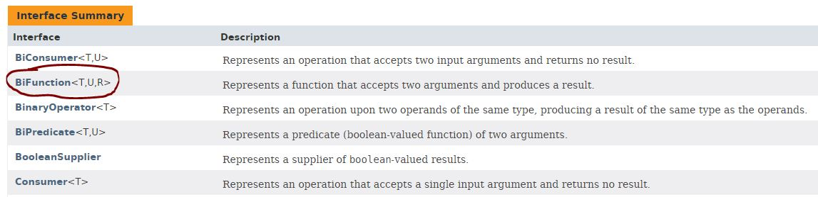
Naming Lambdas (continued)

Slide 38
Naming Lambdas (continued)
First Candidate
BiFunction<Employee, Employee, Integer> lambda
= (Employee e1, Employee e2) -> e1.getName().compareTo(e2.getName());

Slide 39
Naming Lambdas (continued)
There is another possibility that we have already seen in the examples. Recall that a Comparator accepts two arguments and returns an integer – positive integer means “greater than”, negative integer means “less than”.
Second Candidate
Comparator<Employee> lambda
= (Employee e1, Employee e2) -> e1.getName().compareTo(e2.getName());
The Second Candidate is also correct. The lambda can be typed in either way.

Slide 40
Naming Lambdas (continued)
Question: Which of the two candidates should be used?

Slide 41

Naming Lambdas (continued)
Question: Which of the two candidates should be used?
Answer: It depends on how you intend to use the lambda. In this case, it is likely that the lambda is designed as a Comparator for sorting. Only the Comparator type can be used for this purpose

Slide 42


Naming Lambdas (continued)
Question: Which of the two candidates should be used?
Answer: It depends on how you intend to use the lambda. In this case, it is likely that the lambda is designed as a Comparator for sorting. Only the Comparator type can be used for this purpose
This code works
This code does not work

Slide 43
Naming Lambdas (Continued)
[Optional] NOTE: Although every lambda is a realization of a functional interface, the way in which the Java compiler translates a lambda into a realization of such an interface is not obvious. Historically, the possibility of simply translating the lambda into an anonymous inner class was considered by the Java engineers, but was rejected for a number of reasons. One reason is performance – inner classes have to be loaded separately by the class loader. Another is that tying lambdas to such an implementation would limit the possibility for evolution of new features of lambdas in future releases. You can verify that lambdas and anonymous inner classes are fundamentally different (even though very similar) by considering how the implicit object reference `this’ is interpreted by each type: In an anonymous inner class, `this’ refers to the inner class; in a lambda, `this’ refers to the surrounding class. See http://www.infoq.com/articles/Java-8-Lambdas-A-Peek-Under-the-Hood

Slide 44
Syntax Shortcuts via Target Typing
If parameter types can be inferred, they can be omitted
Comparator<Employee> empNameComp = (e1, e2) -> {
if(method == SortMethod.BYNAME) {
return e1.name.compareTo(e2.name);
} else {
if(e1.salary == e2.salary) return 0;
else if(e1.salary < e2.salary) return -1;
else return 1;
}
}
//sort expects a Comparator; since types in emps list are Employee, infer type Comparator<Employee>
Collections.sort(emps, (e1, e2) -> {
if(method == SortMethod.BYNAME) {
return e1.name.compareTo(e2.name);
} else {
if(e1.salary == e2.salary) return 0;
else if(e1.salary < e2.salary) return -1;
else return 1;
}
}
));
See DEMO: lesson8.lecture.lambdaexamples.comparator3

Slide 45
Syntax Shortcuts via Target Typing(cont.)
If a lambda expression has a single parameter with an inferred type, the parentheses around the parameter can be omitted.
Consumer consumer = str -> {System.out.println(str);};
EventHandler<ActionEvent> handler = evt -> {System.out.println(“Hello World”);};

Slide 46
Syntax Shortcuts via Target Typing(cont.)
Method References. (See Lesson 9 for a fourth type of method reference – constructor reference)
Type: object::instanceMethod. Given an object ob and an instance method meth() in ob, the lambda expression x -> ob.meth(x) can be written as ob::meth
Example (see SimpleButton demo in lesson8.lecture.methodreferences.objinstance.print)
Rewrite
button.setOnAction(evt -> p.print(evt));
as
button.setOnAction(p::print);
Another Example: The ‘this’ implicit object can be captured in a method reference in the same way: For instance the method reference this::equals is equivalent to the lambda expression x -> this.equals(x).

Slide 47
Syntax Shortcuts via Target Typing(cont.)
Type: Class::staticMethod. Given a class ClassName and one of its static methods meth(), the lambda expression
x -> ClassName.meth(x)
//or (x,y) -> ClassName.meth(x,y) if meth accepts two args
can be rewritten as
ClassName::meth
Example
(see MethodRefMath demo in lesson8.lecture.methodreferences.classmethod.math)
Rewrite
BiFunction<Integer, Integer, Double> f
= (x,y) -> Math.pow(x, y);
As
BiFunction<Integer, Integer, Double> f = Math::pow;

Slide 48
Syntax Shortcuts via Target Typing(cont.)
Type: Class::instanceMethod. Given a class ClassName and one of its instance methods meth(), the lambda expression
(x,y) -> x.meth(y)
can be rewritten as
ClassName::meth
Example: (str1, str2) -> str1.compareToIgnoreCase(str2)
can be written as
String::compareToIgnoreCase

Slide 49
Connecting the Parts of Knowledge With the Wholeness of Knowledge Declarative programming and command of all the laws of nature
In Java SE 7, the only first-class citizens are objects, created from classes. The valuable techniques of functional programming and a declarative style can be approximated using functional interfaces.
In Java SE 8, functions – in the form of lambda expressions – have become first-class citizens, and can be passed as arguments and occur as return values. In this new version, the advantage of functional programming with its declarative style is now supported in the language
Transcendental Consciousness: TC, which can be experienced in the stillness of one’s awareness through transcending, is where the laws of nature begin to operate – it is the home of all the laws of nature
Impulses Within the Transcendental Field: As TC becomes more familiar, more and more, intentions and desires reach fulfillment effortlessly, because of the hidden support of the laws of nature.
Wholeness moving within Itself: In Unity Consciousness, one finally recognizes the universe in oneself – that all of life is simply the impulse of one’s own consciousness. In that state, one effortlessly commands the laws of nature for all good in the universe.

